Slide 1
Resolving Conflict
How to resolve conflict and still walk away smiling!
Revolution Professional Development
January 4, 2023
Bob Anderson
inLeärning, llc
Notes:
It is a discord of action, feeling, or effect.

Slide 2
Today’s Session
Overview of conflict
Understanding biases
Results of recent research
Causes of conflict
Factors to consider in conflict
Conflict resolution approaches
Strategies to deal with conflict
Notes:
It is a discord of action, feeling, or effect.

Slide 3
Overview of Conflict
Conflict takes place whenever there is a difference of opinion between two people.
Though often seen negatively, healthy conflict can lead to new insights and creative solutions.
To realize these positive outcomes, people need to recognize how they typically deal with conflict so they have the power to change their style when needed.

Slide 4
What are some of your pet peeves?
People parking crooked in the parking lot
People driving slow in the fast lane
Not putting down the toilet seat
Not washing there hands after using the restroom
Heated political discussions
Others?

Slide 5
What are some of your biases?
Age?
Race?
Hair length?
Nationality?
Language?
Others?

Slide 6
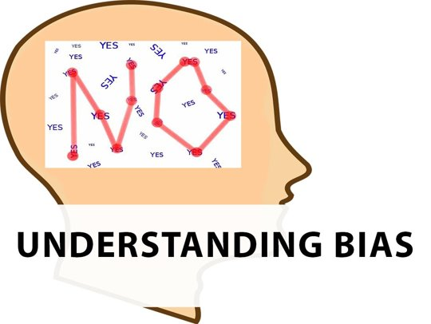
These biases represent how you see the world and how you potentially deal with conflict

Slide 7
We see the world through our lenses
Like a pair of glasses, our biases shape our point of view
Glasses help us focus on the important things
But glasses can also prevent us seeing what we don't want to see.

Slide 8
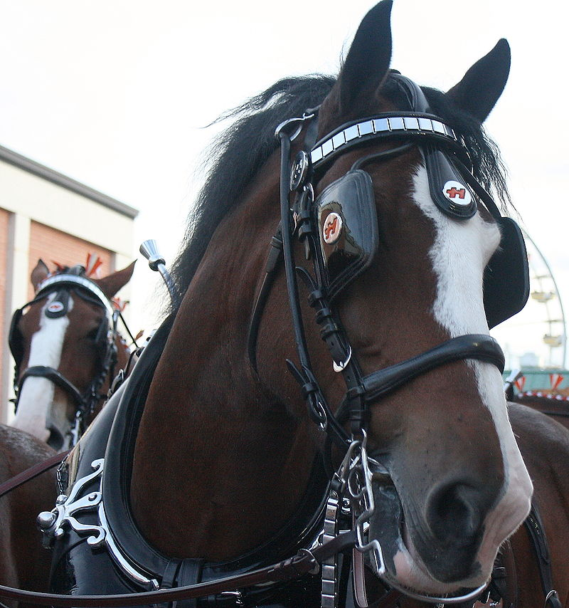
Like blinders on a horse, they prevent us from seeing the entire picture.
This Photo by Unknown author is licensed under CC BY-SA.

Slide 9
Recent Research on Conflict
Conducted by Myers-Briggs Company (2021)
How well people believe they manage conflict.
The costs and consequences of conflict.
How conflict makes people feel.
The role of a manager or supervisor during conflict.

Slide 10
How well do you deal with conflict?

Slide 11
How often do you deal with conflict?

Slide 12
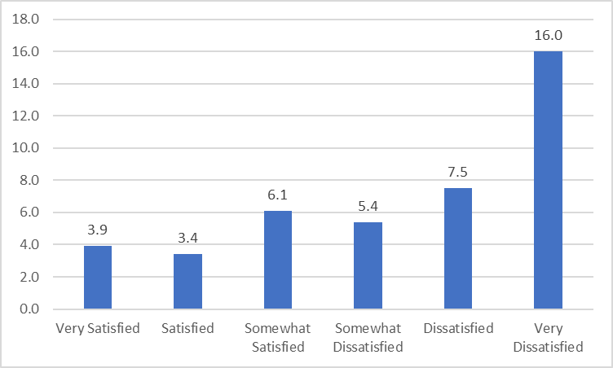
Mean number of hours dealing with conflict for each level of job satisfaction

Slide 13
Other facts about conflict
On average, participants in the research spent 4.34 hours per week dealing with conflict at work.
Conflict can cost your organization approximately $10,000 per year per employee
Conflict causes significant amount of job dissatisfaction which also leads to poor job performance.
94% of workers in one survey said that they had worked with a "toxic" person over the last 5 years.
In a medical study, 71% of doctors and nurses tied interpersonal conflict to medical errors and 27% to patient deaths.

Slide 14
Main causes of conflict

Slide 15
Thomas-Kilmann Conflict Mode Instrument

Slide 16
Various Conflict Resolution Approaches
Avoiding implies avoiding conflict, sidestepping the issue, withdrawing.
Accommodating implies neglecting your own concerns to satisfy the concerns of other people.
Competing implies pursuing your own goals at others' expense.
Collaborating implies working with others to find a solution that fully satisfies the concerns of both parties.
Compromising implies splitting the difference, exchanging concessions, or seeking a quick middle-ground position.

Slide 17
Conflict Strategies
Remember Your Perspective is Just One of Many
Be Aware of Your Biases
Don’t Make it "Me" Versus "Them"
Know Your Goal
Avoid Workplace Venting and Gossip
Experiment to Find What Works
Be – and Stay – Curious

Slide 18
Conflict Strategies
Remember Your Perspective is Just One of Many
It's not realistic to expect everyone will see you eye to eye
Most of us assume we are seeing the issues objectively and correctly
Those that don't, we view as uninformed, irrational or biased.
This is known as naïve realism
Don’t spend time reliving the facts, instead focus on what should happen moving forward.

Slide 19
Conflict Strategies
2. Be Aware of Your Biases
One common derailer is fundamental attribution error – an inclination to assume others behavior has more to do with their personality than the situation.
Example - a colleague is running late for a meeting
Also be aware of confirmation bias - the tendency to interpret events as proving the truth of existing beliefs
Challenge your own assumptions and biases
Ask a trusted colleague to help you see the other point of view

Slide 20
Conflict Strategies
3. Don't Make it "Me" versus "Them"
Don't think in polarizing ways – one person is being difficult and the other one isn't.
Instead think about 3 different entities – you, the other person and the dynamic between you.
Instead of challenging the other person, work to make progress on the third entity – the dynamics.
Think of problematic coworkers as a colleague that you share a problem that needs to be solved.

Slide 21
Conflict Strategies
4. Know Your Goal
To avoid drama, create a clear goal for your problem solving
Do you want to get the project over the finish line or do you want to build healthy working relationships?
Make a list of your goals and then focus on the most important ones – your intentions will determine how you act.
Once you've decided what you want to accomplish, you should write it down and stay focused on it.
Written goals are 1.5 times more likely to be accomplished.

Slide 22
Conflict Strategies
5. Avoid Workplace Venting and Gossip – Mostly
Venting and sharing frustrations can help validate your view and develop a sense of connectedness with others
Studies show that gossip can be beneficial in deterring others from behaving selfishly
But there are risks – gossip heightens the risk of confirmation bias and reinforces a potentially wrong understanding
It's perfectly fine to seek help from others when sorting out feelings, but choose whom you talk to carefully

Slide 23
Conflict Strategies
6. Experiment to Find What Works
There isn't one single way to deal with a toxic or condescending co-worker
Strategies depend on the context – who you are, who the other person is, the nature of the relationship, norms of your organization and other factors
Start by coming up with 2-3 methods you want to test, and then determine what you will do differently.
Don't assume your tactic will work, instead think of it as an experiment.
Try to interrupt the conflict pattern of the past

Slide 24
Conflict Strategies
7. Be and Stay Curious
"Certainty is the enemy of change" - Salvador Minuchin
When dealing with a negative coworker don't think they will always be that way
Instead adopt a curious mindset and maintain hope
Research shows that curiosity brings a host of benefits – it wards off confirmation bias, prevents stereotyping and helps you approach the situation with creativity.
Don't approach it with unflattering conclusions, but instead posing genuine questions.

Slide 25
Conclusion
Sometimes change isn't possible, regardless of what you do
At times you may need to cut the relationship loose and focus on protecting your career and well-being
But using these strategies and applying good faith efforts and hard work can resolve some of the trickiest interpersonal conflicts

Slide 26
Final thoughts...
Remember to take off your blinders
Yours is not the only point of view
Give "air time" to your colleagues
Assume the best in each other
"Seek first to understand, then be understood"
Steven Covey

