Slide 1
Kay Christian

Slide 2
Purpose/Objectives
Enhance your ability to provide feedback in a manner that will build mutual respect and trust and improve work performance.
Recognize the challenges and benefits of providing constructive feedback
Learn techniques for giving positive feedback
Develop and action plan for planning and giving feedback

Slide 4
What kind of Leader are you?
How would your employees rate you?
Are you approachable?
Do you give feedback?
Do you continuously train?
Do you give rewards?
Do you really listen?
Are you reliable?

Slide 5
10 Most Common Mistakes
Not Providing Feedback
Not Making Time for your Team
Being too “Hands-Off”
Being too Friendly
Failing to Define Goals
Misunderstanding Motivation
Hurrying Recruitment
Not “Walking the Walk”
Not Delegating
Misunderstanding Your Role

Slide 6
Withholding constructive feedback is like sending people out a dangerous hike without a compass.

Slide 7
“One of the greatest gifts you can give another human being is constructive feedback on a blind spot they never knew they had…Care enough to give honest, accurate feedback."
Steven Covey

Slide 8
Difficult Personal Conversations
Have conversation in a private space
Consider culture
Give feedback kindly and compassionately

Slide 9
“Whew! I can smell your food down the hall.”
“You probably don’t realize, but your voice can really carry.”
Food on face

Slide 10
“Do you have a minute to chat? I have something to talk to you about that could be a little uncomfortable.”
“I care about you and your success. I noticed that you have had body odor lately, and I do not want this to be the reason that people do not want to work with you.”
“I would want to know if….”

Slide 11
Basic Principles
Focus on the situation, issue, or behavior, not on the person
Maintain the self-confidence and self-esteem of others
Maintain constructive relationships with your employees, peers, and managers
Take initiative to make things better
Lead by example

Slide 12
Compliments
Catch them doing something right
Everyone likes to be appreciated
Be generous but sincere

Slide 13
Feedback Tips
Never give feedback when angry
Be specific
Describe the impact on you or others
Avoid being judgmental
Use positive body language

Slide 15
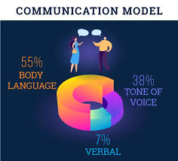

Slide 16
Body Language/Tone of Voice
Have a positive and caring tone of voice
Maintain eye contact
Lean forward
Don’t cross your arms
Don’t raise your voice
Smile
Nod to show you are listening
Respond appropriately Ex: yes, mhm, ask questions

Slide 17
Reading Body Language
Body Language
Meaning
Clasp hands behind back
Arms crossed
Stand too close
Failure to look in eye
Pointing
Angry
Closed, defensive
Aggressive, invading space
Lack of confidence; insincere
Aggressive

Slide 18
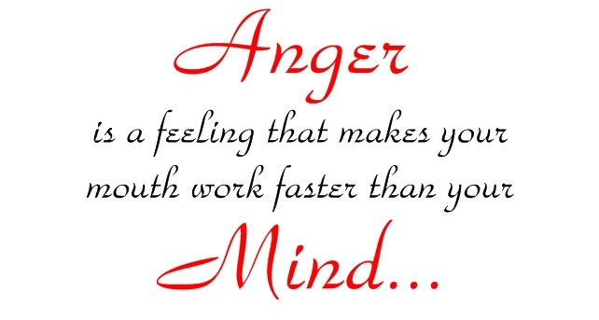
Losing your temper
Count silently to 10
Walk away and come back
Ask yourself if there is a reason for the situation
It is not okay to lose your temper with co-workers
Focus on situation, not the person

Slide 19
EQ Is……..
Understanding your emotions and managing them effectively
Helping you say the right thing and accurately judging how the other person is reacting.
Self awareness - knowing what you are feeling when you are feeling it
Self regulation - using your emotions to serve you not get in the way.
Motivation: persevering when faced with setbacks or frustrations
Empathy - sensing what others are feeling
Social skills - interacting with others comfortably
Understanding how others perceive you

Slide 20
When to Give Feedback
ASAP – give as close as possible to when the incident occurs
Regularly, not just once or twice per year

Slide 21
Avoiding Killer Phrases
Statement/Phrase | Reponse
You have to…………
Why did you?
Yes, but…………
You make me……….
You didn’t listen

Slide 22
Stay calm & stick to subject
Avoid using the word “you” or “you’re” in the beginning of the sentence.
Use “I” statements to make a point. EX: “I noticed……

Slide 23
How to Start
“I have a concern”
“I feel I need”
“I want us to discuss”
“I have some thoughts about”

Slide 24
How to Start?
“I am uncomfortable having this conversation with you, but I feel it is important for your department and the company.”
“Can I have this conversation with you now?”

Slide 25
Feedback Planning
Explain the purpose of your feedback
Describe specifically what you have observed
Describe the impact of their behavior or actions
Give the other person the opportunity to reply
Collaborate with employee to reach solutions

Slide 26
Explain the Purpose of Your Feedback
Be positive in explaining the purpose of your feedback.
“John, it is important to meet our production numbers this week, and reports show your line is behind. Let’s take a look at how we can get back on track.”

Slide 27
Describe Specifically What You Have Observed
Be brief and focus on the behavior, not the person. It helps to focus on what you have observed.
“Production reports indicate there is a 500-unit deficit in production this week.”

Slide 28
Describe the Impact of Their Behavior or Actions
“This is important because customers are complaining that their deliveries are late.”

Slide 29
Give the Other Person the Opportunity to Reply
Helps employee feel they have a part in the solution and build self-esteem
Clears up any miscommunication
Might learn additional information
“Please share your thoughts on how we can meet goals this month.”
“Is there something I am not aware of?”

Slide 30
listen
Do not interrupt
Make eye contact
Actively listen

Slide 31
Collaborate With Employee to Reach Solutions
Ask employee for their suggestions
Offer suggestions
“What do you think?”
What ideas do you have?”

Slide 32
When Receiving Feedback
Listen objectively without interrupting
Avoid taking feedback personally
Hear the truth behind the feedback
Clarify feedback
Avoid becoming defensive
Be open to suggestions

Slide 33
Paper Folding Exercise – 2 minutes
You are effective for me because……
You could be more effective for me if you would…...

Slide 35
Questions

